Slide 1

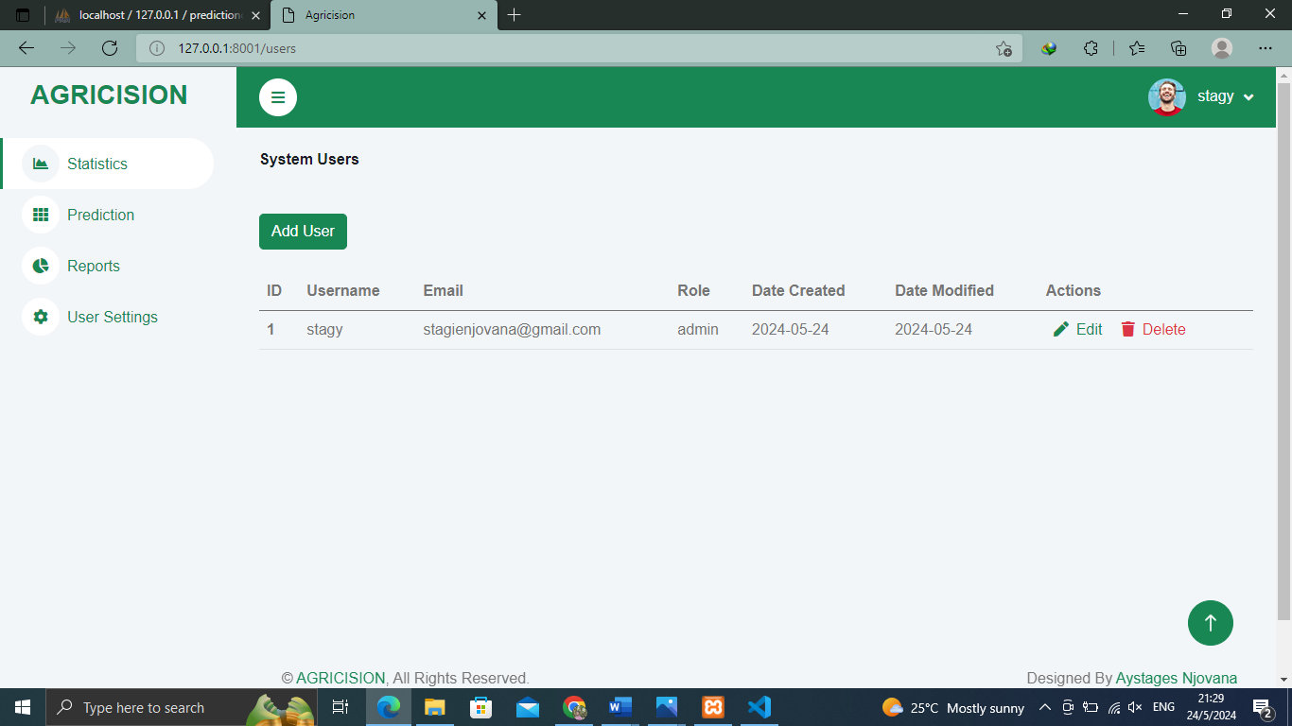
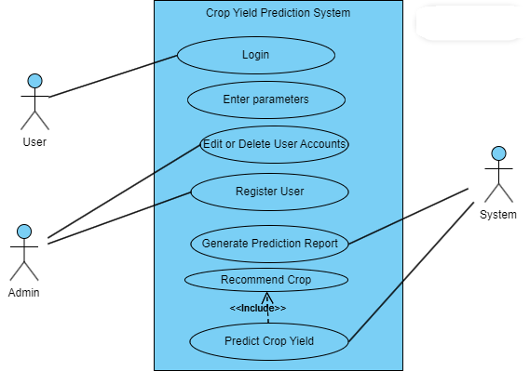
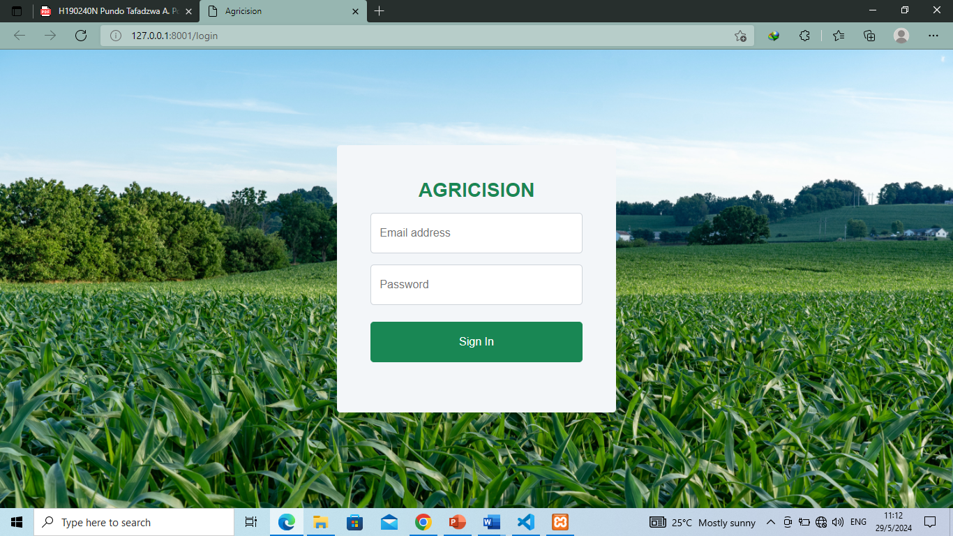
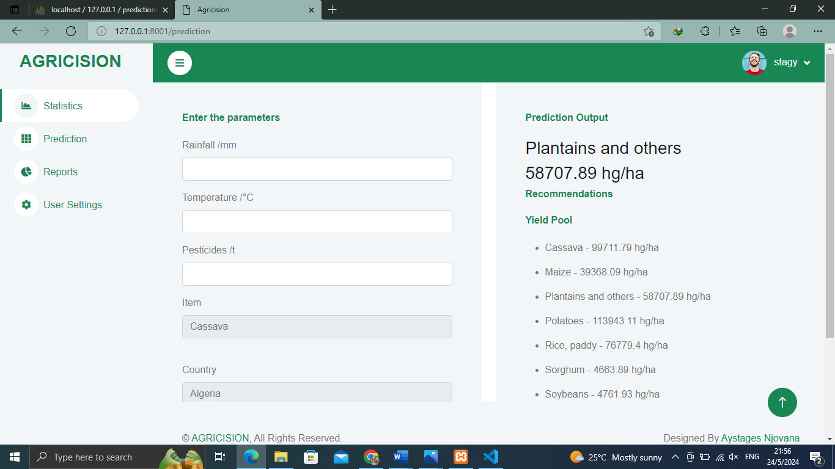
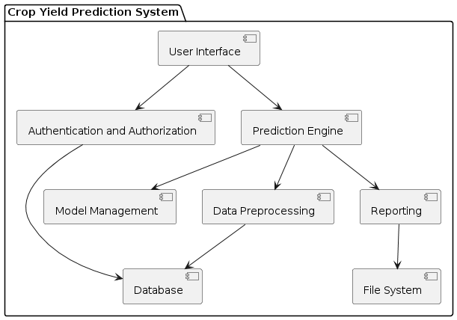
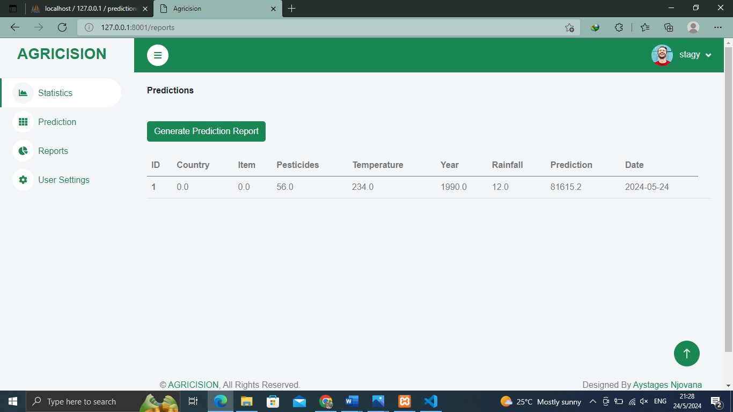
CROP YIELD PREDICTION SYSTEM
Aystages Njovana - Software Engineering Department
1.0 Abstract
4.0. Overview of the developed application
7.0. Use Case Diagram
The agricultural sector plays a pivotal role in ensuring food security and sustaining livelihoods worldwide. Crop yield prediction is a fundamental aspect of agricultural planning and decision-making processes. Traditional methods of yield estimation often lack accuracy and fail to capture the dynamic nature of environmental factors influencing crop growth. In response, this software employs machine learning algorithms to predict crop yields with improved precision and reliability. By leveraging historical data, weather patterns and other relevant parameters, this software facilitates informed decision-making for farmers, agronomists, and policymakers. This paper outlines the development and implementation of my crop yield prediction software, highlighting its potential to revolutionize agricultural practices and enhance productivity.
The Crop Yield Prediction System is a valuable tool that provides an effective means of yield prediction for farmers and agronomists. There are several reasons why this system is justified and important:
Improved Crop Planning: The system enables informed crop planning and management strategies based on accurate yield forecasts, reducing uncertainty and optimizing resource allocation.
Enhanced Productivity: By leveraging predictive analytics, the system enhances productivity and profitability for farmers, promoting economic sustainability and food security.
Sustainable Agriculture: It supports sustainable agricultural practices by promoting efficient resource use, reducing waste, and mitigating environmental risks associated with crop production.
Conclusion
2.0. Introduction
5.0. Objectives
8.0. Screenshots
The Crop Yield Prediction System represents a significant step forward in leveraging machine learning for agricultural productivity. By providing accurate predictions and valuable insights, the system empowers farmers to make data-driven decisions, ultimately enhancing crop yields and resource management. The successful implementation and testing of the system demonstrate its potential impact on the agricultural sector. However, continuous improvements and expansions are necessary to fully realize its potential. Future work should focus on integrating advanced technologies, expanding crop coverage, and enhancing user accessibility to ensure the system remains a valuable tool for farmers worldwide.
In an era marked by population growth, climate variability, and evolving agricultural practices, ensuring global food security has emerged as a paramount challenge. At the heart of this challenge lies the ability to predict and optimize crop yields with precision and reliability. Traditional methods of yield estimation often fall short in capturing the complex interplay of environmental factors that influence crop growth, leading to suboptimal decision-making for farmers and policymakers alike.
To address this pressing need, my project endeavors to harness the power of machine learning to revolutionize crop yield prediction. By leveraging historical data, real-time weather information, soil characteristics, and agronomic practices, our software aims to provide accurate and actionable insights into future crop yields. Through the integration of advanced algorithms and predictive modeling techniques, we seek to empower agricultural stakeholders with a tool that not only forecasts yields but also identifies optimal strategies for enhancing productivity and resilience in the face of changing
To predict crop yield using Area(e.g Zimbabwe), Item(e.g Wheat), Year, average_rain_fall_mm_per_year,pesticides_tonnes and avg_temp
To suggest the best crop to plant according to the parameters provided
To generate prediction reports for future cross referencing
3.0. Problem definition
6.0. System Overview
The agricultural sector faces challenges in accurately predicting crop yields due to complex interactions between environmental factors, crop management practices, and natural variability. Traditional methods of yield estimation often lack precision and scalability, leading to suboptimal decision-making and resource allocation in farming operations. There is a critical need for an advanced crop yield prediction software solution that leverages machine learning techniques to enhance predictive accuracy, support data-driven decision-making, and optimize agricultural productivity. The variability of environmental factors such as weather patterns, soil conditions, and pest/disease outbreaks complicates accurate yield estimation using conventional methods and also traditional approaches to yield prediction struggle to scale with increasing data volumes and geographic diversity, hindering their effectiveness in diverse farming contexts.The successful development and implementation of a crop yield prediction software using machine learning techniques will enable stakeholders in the agricultural sector to make informed decisions, improve productivity, and promote sustainable farming practices. By harnessing the power of data analytics and predictive modeling, the software aims to revolutionize crop yield estimation and support the transition towards data-driven agriculture.
Supervisor- Mr W . S Manjoro

